Slide 1
British Airways Customer Experience (CX) Analysis
Hanish Paturi
Data Scientist, Cofounder, Agera Consultants
Report on Customer Sentiment, CX Challenges
Analyzing Business Impact by using customer information and research
Recommendations on resolving challenges and improving CX
Scraping and Analytics Notebooks
Notes:
20 seconds

Slide 2
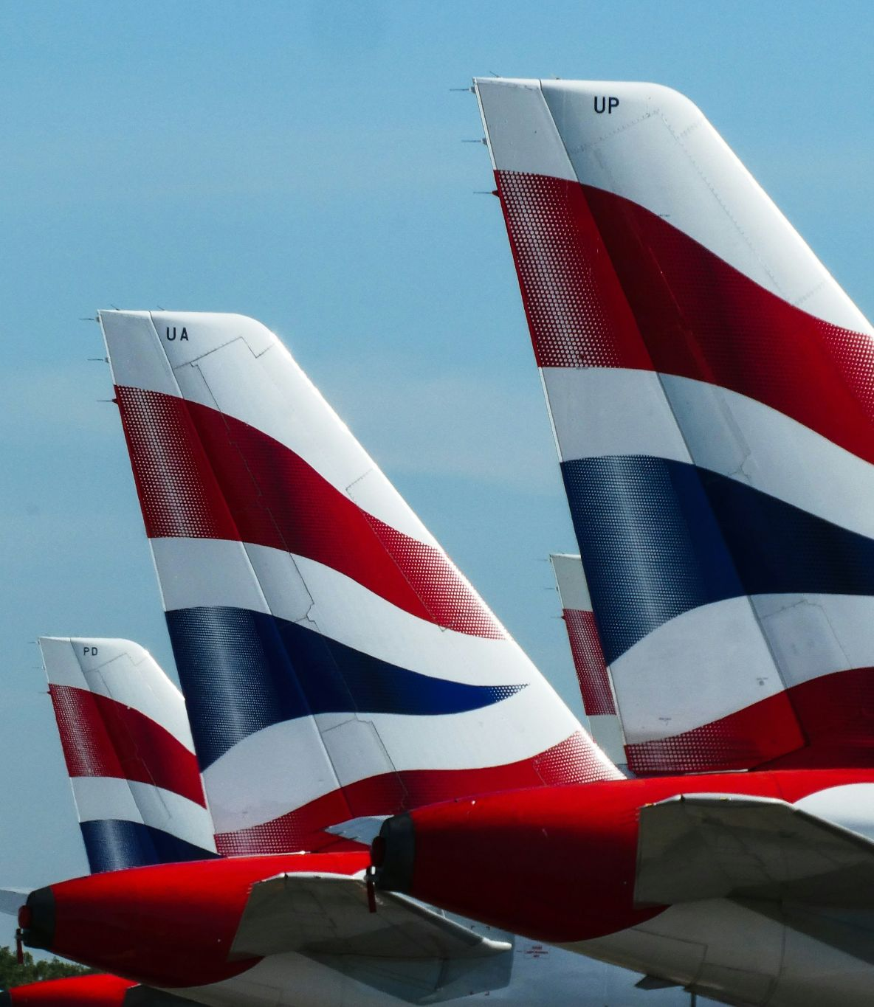
Context
British Airways is UK’s flag-carrier airline, and has maintained market dominance, despite numerous setbacks over the years, due to strategic decision-making by the leadership.
However, COVID’s impact on revenues and customer sentiments have been devastating, and a strong recovery is needed to avoid customer churn.
Notes:
15 seconds

Slide 3

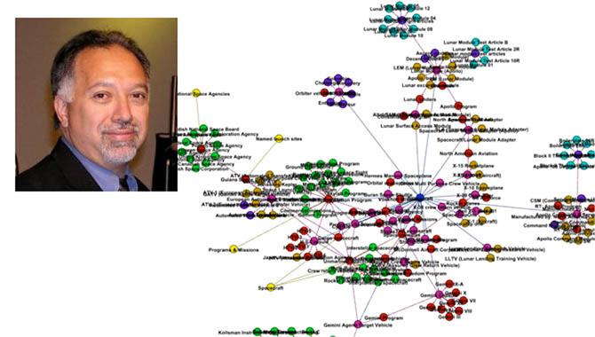

Major Techniques used
Sentence Embeddings
Topic Models
LLM
Express customer reviews as vector representations with Google’s Universal Sentence Encoder
Extract hidden themes, identify problems, using BERTopic topic modeling, UMAP and HDBSCAN
Standardize topic labels for analyzing Business Impact of identified problem areas
Notes:
1 min

Slide 4
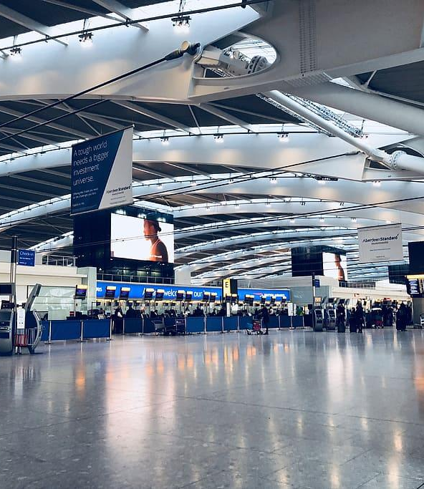
Introduction to British Airways CX Analysis
Overview
British Airways CX Analysis is an assessment of the customer experience provided by British Airways, based on user reviews and independent research, with two main objectives:
Identify opportunities for enhancing customer satisfaction
Analyze customer feedback and data and provide recommendations for enhancing the overall CX
Notes:
30 seconds

Slide 5
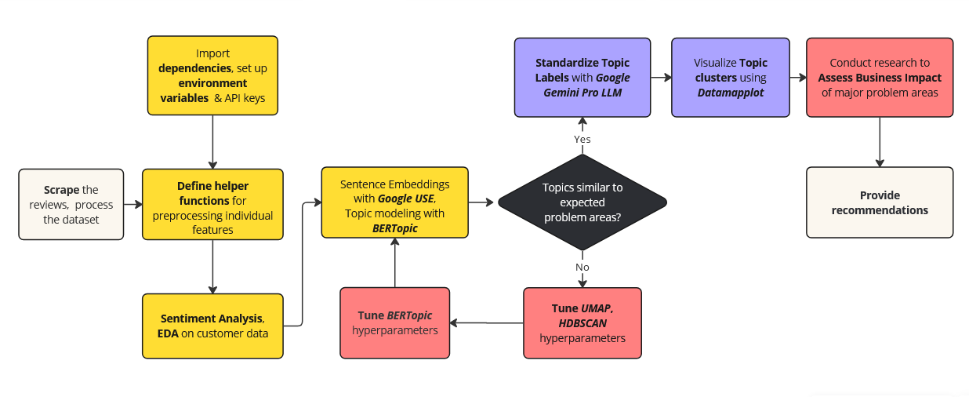
Workflow Scraping and Analytics Notebooks
Made with Miro: https://miro.com
Notes:
1 min

Slide 6
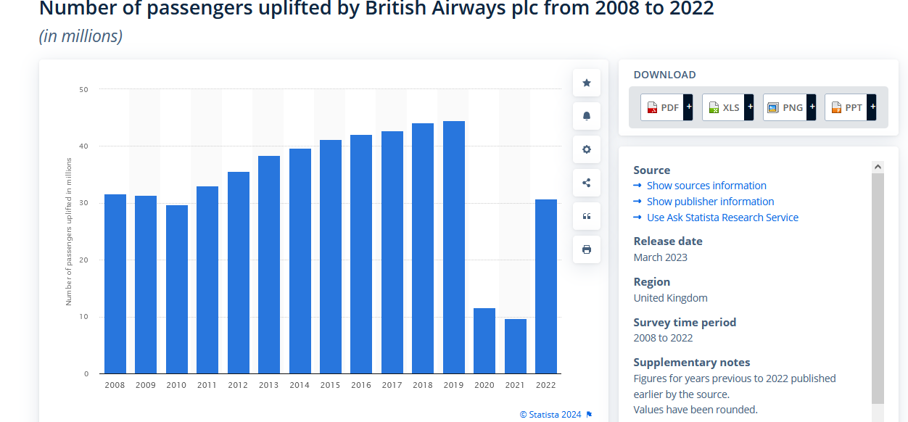
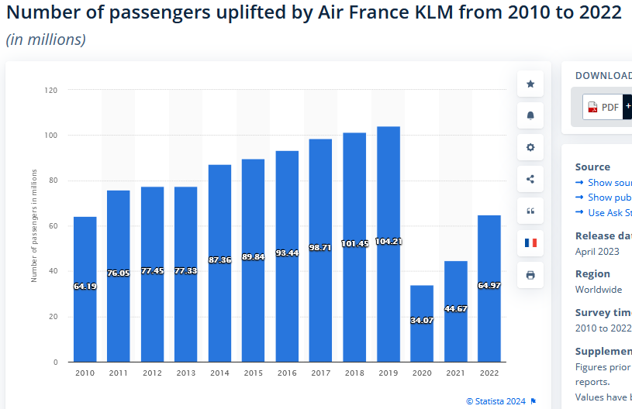
The Market Scraping and Analytics Notebooks
Dissatisfaction among BA’s core customer base, as service picks up post-COVID
Competitors like KLM seeing a similar uptick in service
75% of airline profits typically from Business Class [Investopedia]
Churn risk, market dominance and profitability: Negative user sentiment for BA in Cutomer Service, in the context of massive staff layoffs in the wake of COVID
Notes:
5 seconds
https://www.statista.com/statistics/309349/british-airways-uk-passenger-numbers/
https://www.theguardian.com/business/2020/apr/28/british-airways-plans-to-make-up-to-12000-staff-redundant

Slide 7
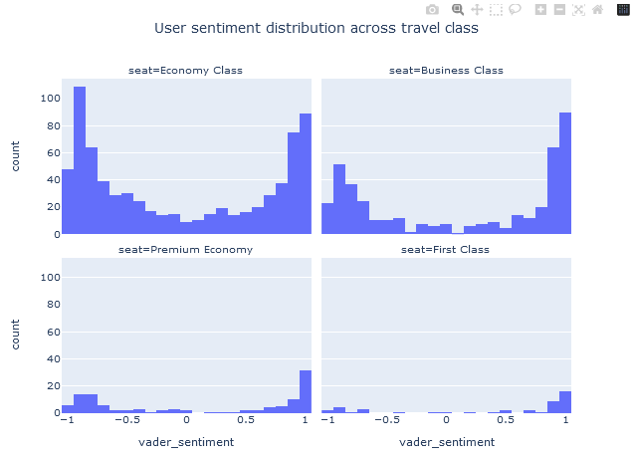
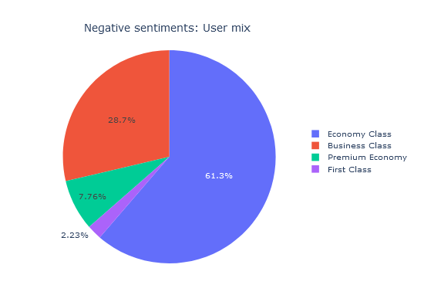
User Sentiment Scraping and Analytics Notebooks
Note: High selection bias observed (possible volunteer/social etc biases present). People with extreme experiences have provided reviews. Cross-verify with user-data in real-time.
Reviewer mix by fare class, same as core customer base: Core customer base is Economy and Business Class
High dissatisfaction in core customer base: Negative sentiments predominantly from Economy & Business classes (Pie chart)
Churn risk & overall customer satisfaction and loyalty: Specific concerns and issues to be identified & addressed
Topic Modeling techniques: To identify underlying themes (BERTopic/ Top2Vec/ LDA/ LSA etc.)
Notes:
10-15 seconds

Slide 8
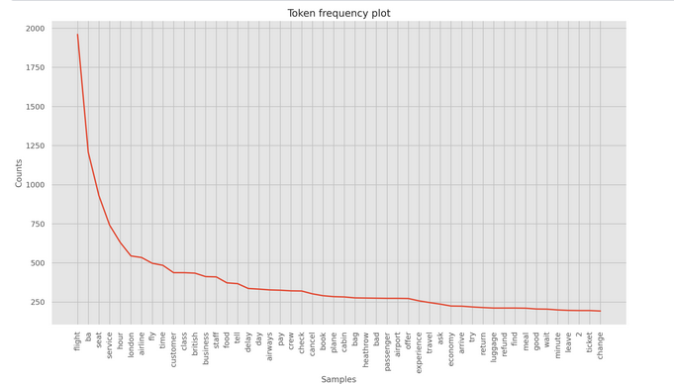
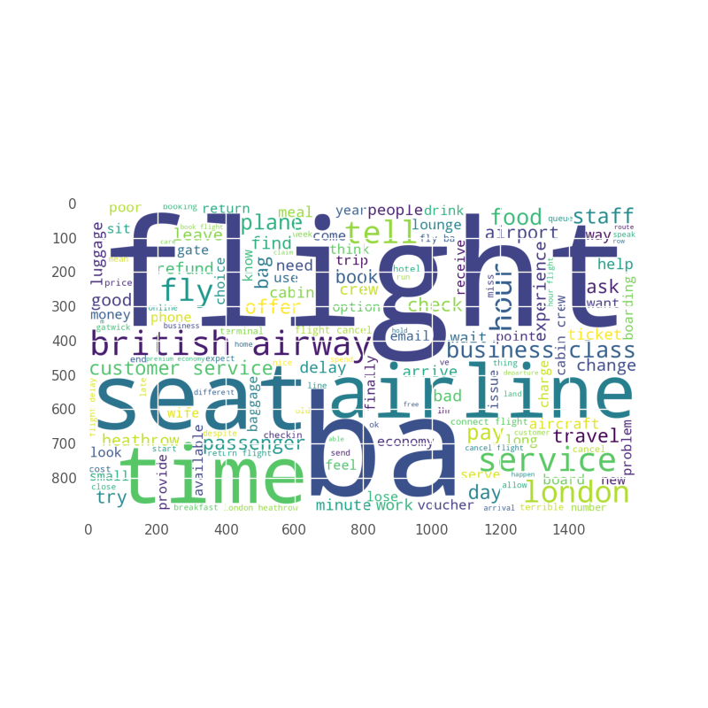
Domain Words: WordCloud, FreqDist Scraping and Analytics Notebooks
Some common tokens (such as ‘flight’, ‘ba’) spuriously increase sentence similarity (cosine)
Stop words, domain words and other “non-informative” tokens discarded to improve discriminative power of topic model
HDBSCAN clustering performance improves, by clustering around less-frequent, topic-specific tokens
Notes:
5 seconds

Slide 9
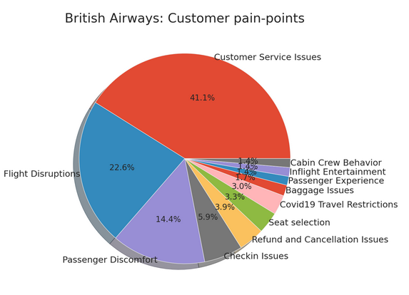
Topics detected with BERTopic
& Google Gemini Pro Scraping and Analytics Notebooks
Note: High selection bias observed (possible volunteer/social etc biases present). People with extreme experiences have provided reviews. Cross-verify with user-data in real-time.
Top 5 Issues affected ~85% reviewers
Perfom cost impact analysis: cost factor, time, econometric approaches
Customer Service: Surveys, statistical tests and custom metrics to quantify system effectiveness and airport operational performance
Check-ins, refunds and cancellations: AI powered web applications flag user complaints and process requests in real time
Self check in kiosks at busy hubs can reduce customer wait times

Slide 10
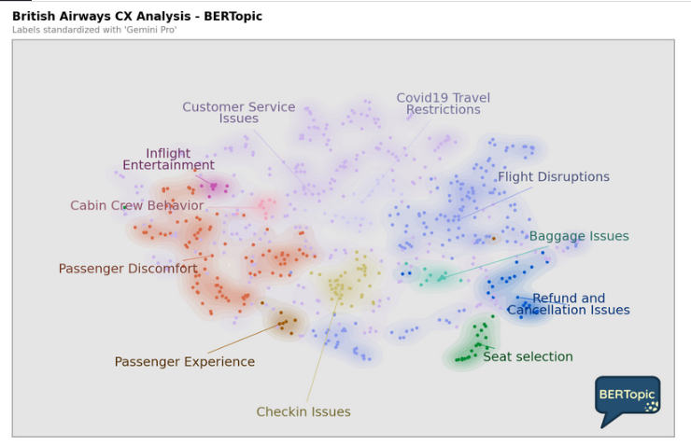

Visualizing Inter-topic Distance
Scraping and Analytics Notebooks
Note: High selection bias observed (possible volunteer/social etc biases present). People with extreme experiences have provided reviews. Cross-verify with user-data in real-time.
Visualizing 2D representation of Sentence embeddings, obtained through UMAP dimensionality reduction, clustered by HDBSCAN, colored by topic labels.
Topic model developed with BERTopic, best suited for docs < 1000 in number
Raw topic labels not intuitive enough, provides little context, not business-friendly
Standardize and refine raw topic labels: In-context learning with LLM: concatenation of representative docs, topic labels as input text, as input prompt template for Google Gemini Pro
Generated with Datamapplot

Slide 11
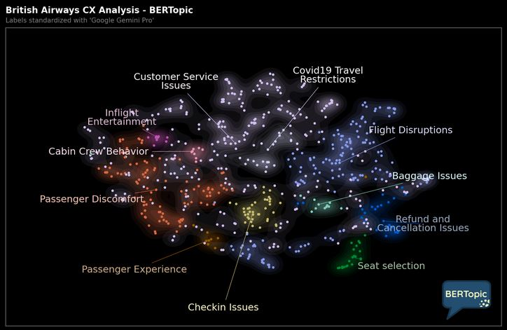
Visualizing Inter-topic Distance
Scraping and Analytics Notebooks
Note: High selection bias observed (possible volunteer/social etc biases present). People with extreme experiences have provided reviews. Cross-verify with user-data in real-time.
Visualizing 2D representation of Sentence embeddings, obtained through UMAP dimensionality reduction, clustered by HDBSCAN, colored by topic labels.
Topic model developed with BERTopic, best suited for docs < 1000 in number
Raw topic labels not intuitive enough, provides little context, not business-friendly
Standardize and refine raw topic labels: In-context learning with LLM: concatenation of representative docs, topic labels as input text, as input prompt template for Google Gemini Pro

Slide 12
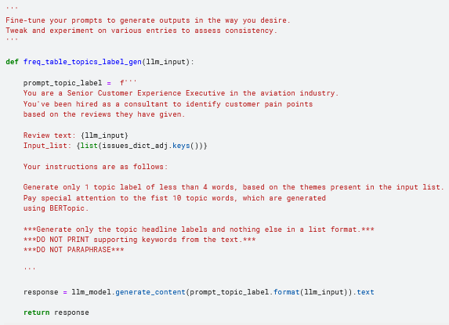
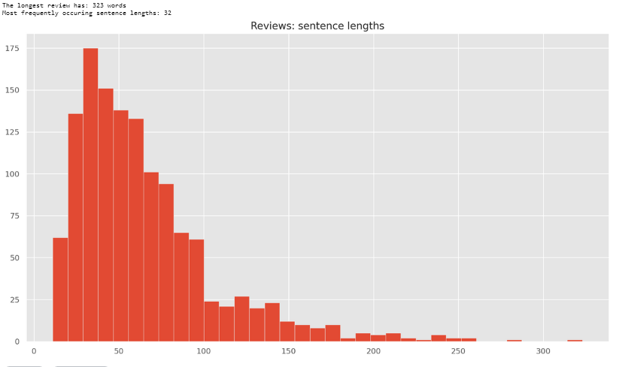
Standardize topic labels: LLM In-context learning
Scraping and Analytics Notebooks
Gemini Pro, for regenerating business-friendly topic labels.
Review Text: Prompt inputs were a concatenation of raw topic labels and representative documents.
Additional support given by seed topics, corresponding to commercial aviation expected core CX areas.

Slide 13
Resolving CX challenges: Recommendations
41%
23%
14%
12%
6%
4%
Customer Service
Flight Disruptions
Passenger Discomfort
In-flight service, Baggage Handling, misc.
Check-ins
Refunds and Cancellations
Streamlined booking, Dedicated helpline:
AI-integrated app with chatbots, trained helpdesk operators
Communication & service disruptions: App alerts, push-messaging, strategic partnerships w/ network providers
Trained flight attendants; Hygiene, aircrafts outfitted with essentials - charging ports, Wi-Fi, and in-flight entertainment
.
Trained flight attendants; Reliable baggage handling, Incentives, incident reporting and performance reviews; pay-hikes to staff
Streamlined check-in process: Improved app design with AI-integrated features for enhanced CX;
Self check-in kiosks
Payment intermediaries and gateways; App alerts to notify cancellations and failed bookings
Invest in app design and integrate user feedback
Deploy chatbot powered by fine-tuned LLMs
Train helpline operators, incentivize performance
Real-time notifications
Efficient rebooking procedures
Collaborate with network providers for a seamless experience
Upgrade seating comfort options, and crew service
Improve onboard amenities.
Enhance cabin temperature control.
Continuous staff training programs
Issue resolution protocols
Performance-driven staff incentives
Efficient baggage handling systems
Deploy Queue Management Systems at airports
Personalised check-in assistance
Intuitive self check-in kiosks and web checkin interface
Automated notification systems
Dedicated customer service support, with AI chatbot integration
Expedited refund processing time and simplified procedures

Slide 14
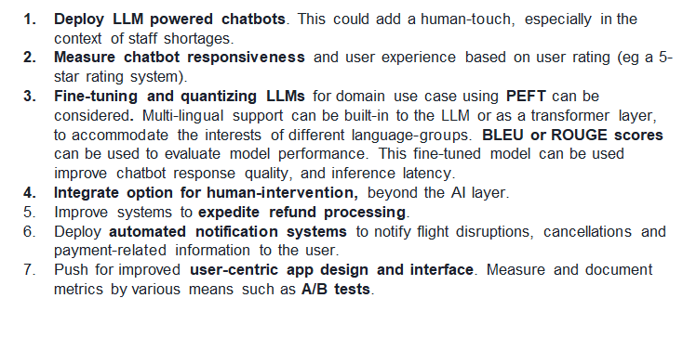
Recommendations for BA Engineering and Analytics
Real-time notifications
Efficient rebooking procedures
Collaborate with network providers for a seamless experience

Slide 15
Recommendations for BA Engineering and Analytics
﻿Deploy LLM powered chatbots. This could add a human-touch, especially in the context of staff shortages.
Measure chatbot responsiveness and user experience based on user rating (eg a 5- star rating system).
Fine-tuning and LLM quantization for domain use case using PEFT can be considered. Multi-lingual support can be built-in to the LLM or as a transformer layer, to accommodate the interests of different language-groups. BLEU or ROUGE scores can be used to evaluate model performance. This fine-tuned model can be used improve chatbot response quality, and inference latency.
Integrate options for human-intervention, beyond the Al layer.
Improve systems to expedite refund processing.
Deploy automated notification systems to notify flight disruptions, cancellations and payment-related information to the user.
Push for improved user-centric app design and interface. Measure and document metrics by various means such as A/B tests.
Real-time notifications
Efficient rebooking procedures
Collaborate with network providers for a seamless experience

Slide 16
Recommendations for BA Engineering and Analytics
﻿Deploy LLM powered chatbots to enhance customer interactions, particularly in scenarios with staff shortages, adding a human touch to the service experience.
Evaluate chatbot responsiveness and user experience through user ratings, such as a 5-star rating system, to continuously improve performance.
LLM fine-tuning and quantization techniques, including Parameter Efficient Fine-Tuning (PEFT), to tailor the language model for specific domain use-cases in chatbot applications. Incorporate multi-lingual support either directly into the LLM or as a transformer layer to cater to diverse language groups. Assess model performance using metrics such as BLEU or ROUGE scores to enhance chatbot response quality and to minimize inference latency.
Integrate options for human intervention beyond the AI layer to address complex customer inquiries or situations that require personalized assistance.
Enhance systems for expedited refund processing to improve customer satisfaction and streamline the resolution of payment-related issues.
Implement automated notification systems to proactively inform users about flight disruptions, cancellations, and payment-related information, ensuring timely and transparent communication.
Advocate for continuous improvement in user-centric app design and interface, leveraging techniques such as A/B testing to measure and document metrics for enhancing the overall user experience.
Real-time notifications
Efficient rebooking procedures
Collaborate with network providers for a seamless experience

Slide 17
Sources Scraping and Analytics Notebooks
British Airways - statistics & facts https://www.statista.com/topics/5372/british-airways/#topicOverview
British Airways Plc: Competitors https://www.globaldata.com/company-profile/british-airways-plc/competitors/
How Much Airline Revenue Comes From Business Travelers? https://www.investopedia.com/ask/answers/041315/how-much-revenue-airline-industry-comes-business-travelers-compared-leisure-travelers.asp
British Airways Competitors https://www.comparably.com/companies/british-airways/competitors
British Airways plans to make up to 12,000 staff redundant. BA boss says more than one in four jobs could go as coronavirus causes global collapse in air travel https://www.theguardian.com/business/2020/apr/28/british-airways-plans-to-make-up-to-12000-staff-redundant
British Airways Plc's worldwide revenue from FY 2010 to FY 2022 (in million GBP) https://www.statista.com/statistics/264296/british-airways-worldwide-revenues-since-2006/?kw=&crmtag=adwords&gclid=CjwKCAiAiP2tBhBXEiwACslfnrguU6XsRAXQ25JuO3AEwckyFTHvHdCD9DcUI-8Pr2XRFdLSbYCdXRoCJaEQAvD_BwE
Airport Operational Performance and Its Impact on Airline Cost https://www.researchgate.net/publication/300299980_Airport_Operational_Performance_and_Its_Impact_on_Airline_Cost
Individual Annual Financial Report 2022, IAG https://www.iairgroup.com/investors-and-shareholders/financial-reporting/annual-reports/
Andrijana Bogdanovska Djurovic "Transformational Change or Not?: The Case of British Airways (2008-2010)" https://papers.ssrn.com/sol3/papers.cfm?abstract_id=1947296
Alderighi et al. "A case study of pricing strategies in European airline markets: The London – Amsterdam route" https://www.sciencedirect.com/science/article/abs/pii/S0969699711000226
Gov, S.A. and Dergisi, Y.B. (2020) "Strategic Alliances in airline business: Comparison of Skyteam, Oneworld, Star Alliance groups," [Preprint]. Available at: https://doi.org/10.35408/comuybd.629382.
Graham, A. (2020) "U.K. regional airports" Air Transport and Regional Development Case Studies , pp. 64-85. Available at: https://doi.org/10.4324/9781003092063-5.
Havlovic, S.J. (2020) "European works councils in the airline industry," Strategic Innovative Marketing and Tourism , pp. 1-6. Available at: https://doi.org/10.1007/978-3-030-36126-6_1
Light, L. (2020) British Airways needs to revitalize its Brand , Forbes . Forbes Magazine. Available at: https://www.forbes.com/sites/larrylight/2020/08/14/british-airways-needs-to-revitalize-its-brand/?sh=6eaeef0d747e8888
Real-time notifications
Efficient rebooking procedures
Collaborate with network providers for a seamless experience

Slide 18
Fin.
Real-time notifications
Efficient rebooking procedures
Collaborate with network providers for a seamless experience

